Slide 1
Trans Survivors of Sexual Violence
They/Them/Theirs
Jess Rubinsky, MSW

Slide 2
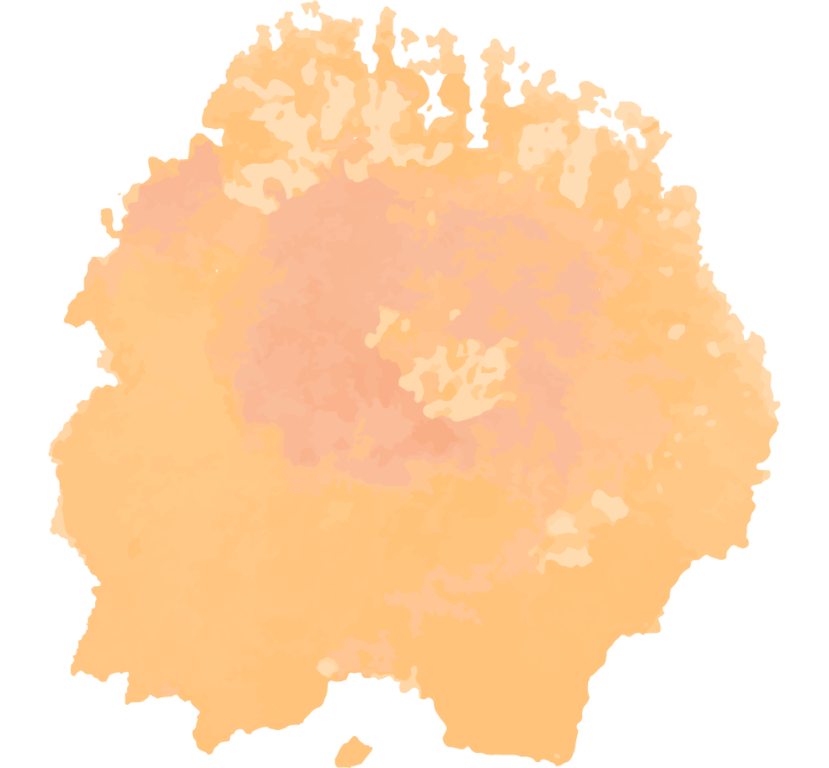
Agenda
Power Dynamics
Welcome
Transformative Justice
Gender 101
Trans Survivors of Sexual Violence
Resources
Notes:
This presentation is designed to be a starting point for talking about trans people and sexual violence. Just as other groups and the trans community itself survivors of sexual violence are not a monolifth. Participants should continue to educate themselves on sexual violence, antiracism, and LGBTQIA+ issues through connecting with organizations, exploring the resource guide, exploring their own biases, and continual learning in order to help violence prevneiton
Trans and LGBT people are not a monolith - all different and have different experiences, needs, and support
Expand understanding and conversation around consent to include agency, power, and communication.

Slide 3
Jam Board
tinyurl.com/NSACTSSV
Anonymous
Interactive Throughout
Different Form of Communication
Notes:
Before we begin I want to remind everyone that if you need to mute me, step out, or anything please do so - take care of yourself.
Before we start we are going to do a quick restorative writing practice
If you can grab a pen and paper or open notes on your computer
This practice was written by Alexandra Elle
Before we begin I want to remind everyone that if you need to mute me, step out, or anything please do so - take care of yourself.
Before we start we are going to do a quick restorative writing practice
If you can grab a pen and paper or open notes on your computer
This practice was written by Alexandra Elle
Alexandra Elle is an author & writing to heal facilitator living in Maryland with her husband and children. Writing came into her life by way of therapy and the exploration of healing through journaling. Quarterly, Alex teaches workshops and retreats centered around assisting others in finding their voices through storytelling rooted in truth without shame. Her mission is to build community & self-care practices through literature & language. She is currently an author at Chronicle Books.
Alex is the author of multiple books and journals, most recently After the Rain and the guided journal, In Courage.She also hosts The Hey Girl Podcast.
First - We are going to name what is feeling heavy. Write down 5 things that you are carrying with you today.
Second - Name what you need to start or continue to heal. Write down 5 ways that you need support today.
Lastly, write down what you would like to let go of. Write five things that you are releasing today.

Slide 4
Alexandra Elle Practice
Name what is Heavy
What you need to Heal
What you need to Release
Notes:
Before we begin I want to remind everyone that if you need to mute me, step out, or anything please do so - take care of yourself.
Before we start we are going to do a quick restorative writing practice
If you can grab a pen and paper or open notes on your computer
This practice was written by Alexandra Elle
Before we begin I want to remind everyone that if you need to mute me, step out, or anything please do so - take care of yourself.
Before we start we are going to do a quick restorative writing practice
If you can grab a pen and paper or open notes on your computer
This practice was written by Alexandra Elle
Alexandra Elle is an author & writing to heal facilitator living in Maryland with her husband and children. Writing came into her life by way of therapy and the exploration of healing through journaling. Quarterly, Alex teaches workshops and retreats centered around assisting others in finding their voices through storytelling rooted in truth without shame. Her mission is to build community & self-care practices through literature & language. She is currently an author at Chronicle Books.
Alex is the author of multiple books and journals, most recently After the Rain and the guided journal, In Courage.She also hosts The Hey Girl Podcast.
First - We are going to name what is feeling heavy. Write down 5 things that you are carrying with you today.
Second - Name what you need to start or continue to heal. Write down 5 ways that you need support today.
Lastly, write down what you would like to let go of. Write five things that you are releasing today.

Slide 5
Gender 101
Notes:
Page three of jamboard there will be a place for questions anonymously

Slide 6
Sex
“Ideal Male” | “Ideal Female”
Lots of Testosterone XY chromosomes Sperm Penis Testicles Facial hair growth Deeper voice Broad shoulders More muscular build | Lots of Estrogen XX chromosomes Ovum Vulva Uterus Little to no facial hair Higher voice Broad hips Breasts
Classification system based on a person’s biology
Notes:
To get started we are going to talk about the difference between sex and gender. Sex is a classification based on a person’s biology. When we think of biological sex we think of the ideal male and ideal female. In addition there is a sex category that includes people whose anatomy does not completely fit into either of society’s typical definitions of male or female called intersex.
“Intersex” is a general term used for a variety of conditions in which a person is born with a reproductive or sexual anatomy that doesn’t seem to fit the typical definitions of female or male. Most people with intersex traits come to medical attention because doctors or parents notice something unusual about their bodies. Intersex people are roughly 1 in every 2,000 people. That’s as common as natural born redheads.

Slide 7
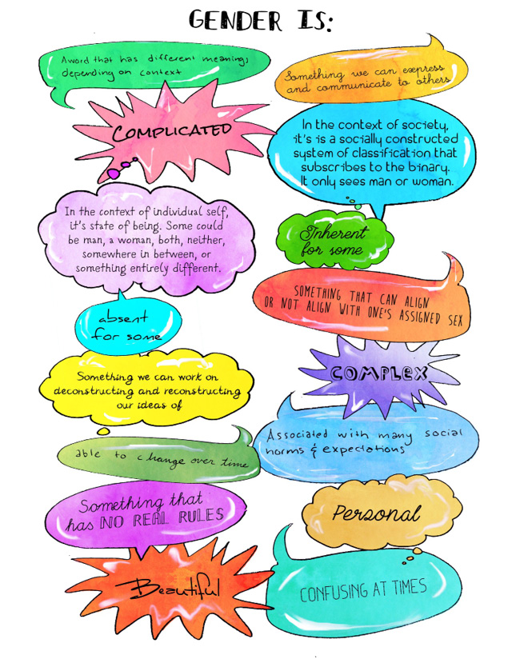
Gender
Classification system based on social ideas of femininity and masculinity
Notes:
Gender is a socially constructed system of classification and assigns a set of cultural expectations of roles, behaviors, expressions and characteristics to each person based on that classification.a
Sex is biologically determined universal from all human beings. Gender is constructed by society, differs across geography, climate, and between cultures, can also change over time

Slide 8
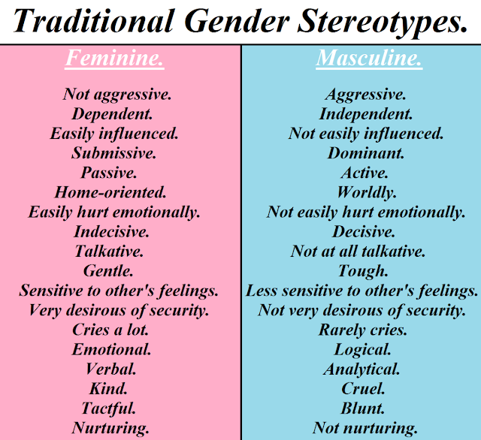
Gender
Notes:
When thinking about gender in our societywe typically think of two. Men and Women. Pink and Blue. I know many people use the man and woman box to talk about the roles that society says that people must be. We have already started to talk in some parts of movement about how gender roles relate to violence. In additon to that we need to have conversations around how the language and assumptions we make contribute to the gender binary and gender roles and lead to violence.
-
Feel Free on fourth page of the Jam board to
This is the gender binary. The idea that there are only two genders and that they are opposite one another. Similarly, there are also cultural expectations of norms, behaviors, and even appearance people should have based on this classification. These are reinforced through gender norms and cultural many things including gender reveal parties, believing that only men should pay for dates or make the first move, and similar things contribute to enforcing the gender binary.
Interestingly enough, there is a large body of evidence, from many different countries and contexts, overwhelmingly points to the link between adherence to rigid gender stereotypes and high rates of violence against women.

Slide 9
Transgender 101
Transgender
Someone whose gender identity is not the same as the sex they were assigned at birth
Cisgender
Someone whose gender identity is the same as their sex assigned at birth
Notes:
Transgender describes someone who does not identify as the same sex they were assigned at birth. Transgender is an adjective. Not a verb or a noun. He is transgender.
Also some words that are outdated, inaccurate or offensive,
Similarly, words like tranny, transvestite, transgendered, shemale
Cisgender refers to someone whose gender identity is the same as their biological sex.

Slide 10
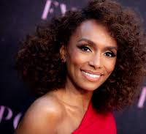
Transgender 101
Transgender Woman
Someone who was assigned male at birth and is a woman
Notes:
Trans Woman is someone who was assigned male at birth and is a woman. Examples of people you may know are Laverne Cox, Jazz Jenings - who is Jewish, and others

Slide 11
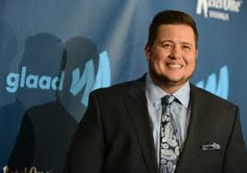
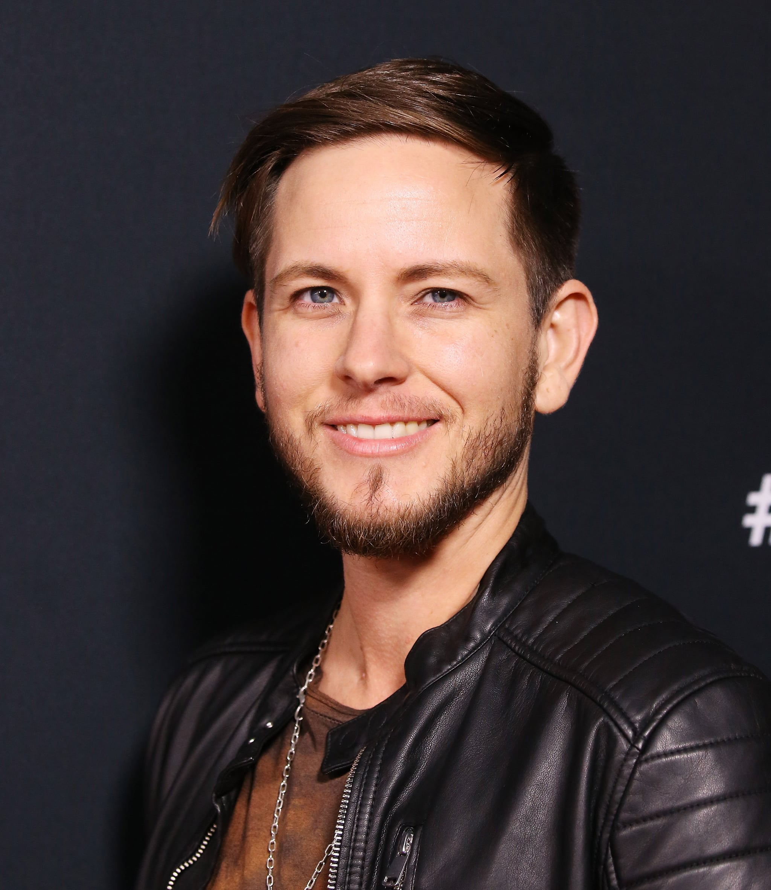
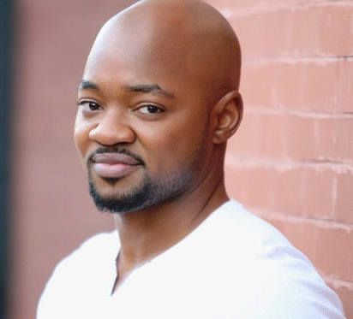
Transgender 101
Transgender Man
Someone who was assigned female at birth and is a man
Notes:
A trans man is someone who was assigned female at birth and is a man. Examples of people you may know are Chad Bono, Brian Michael Smith, Elliot Fletcher, Alex Blue Davis, Ian Alexander, Elliot Fletcher

Slide 12
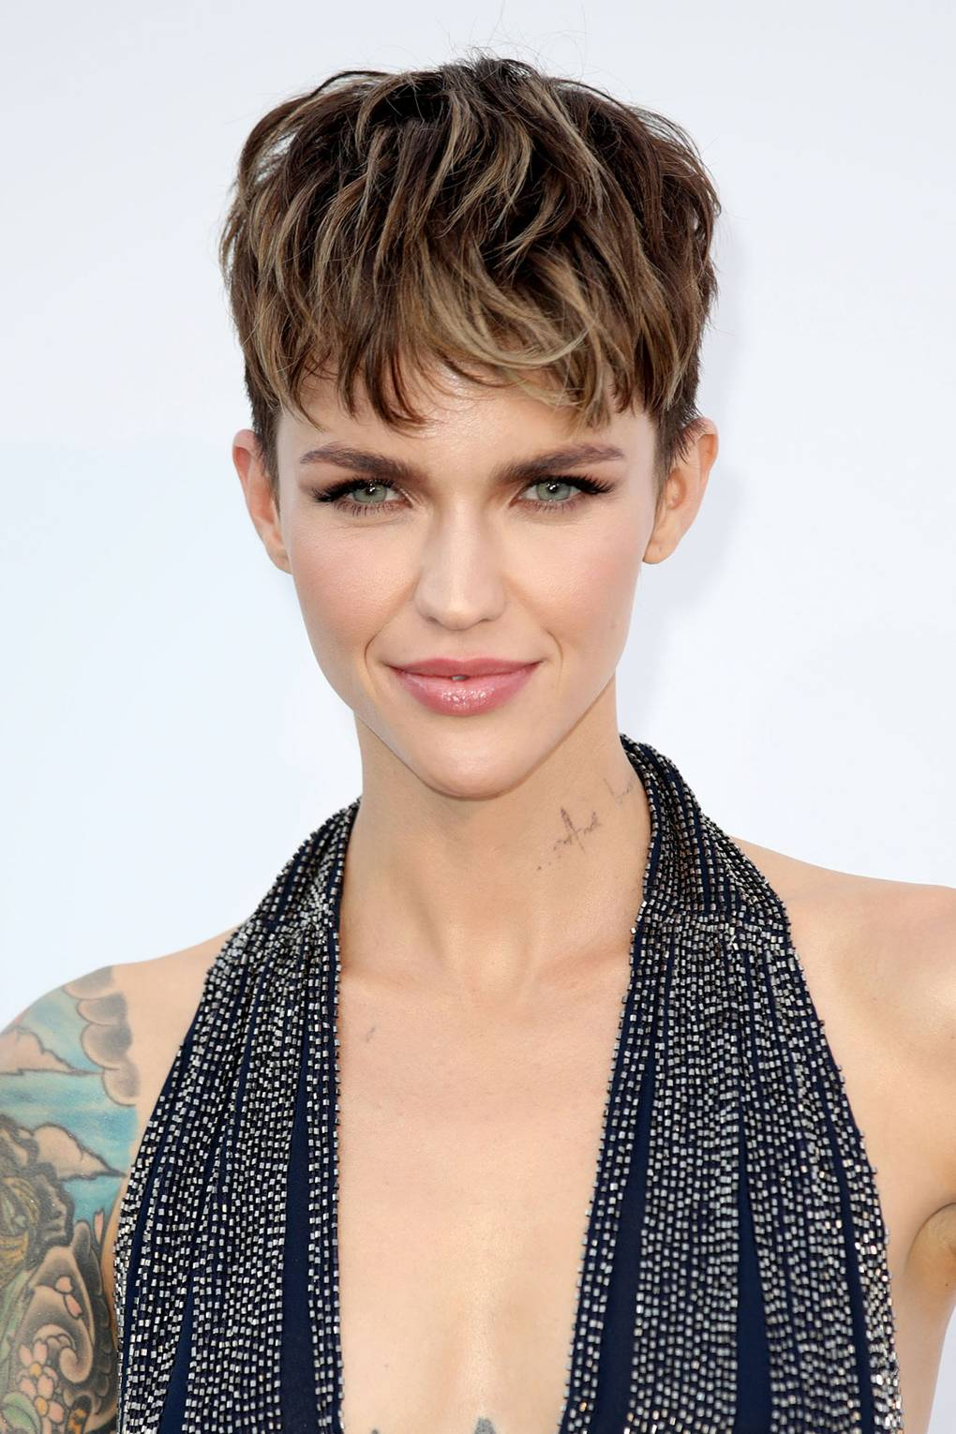
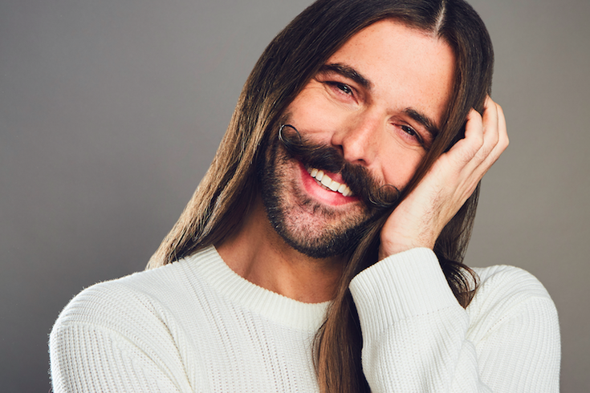
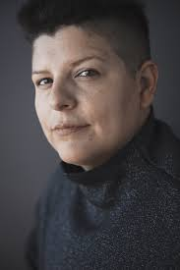
Transgender 101
Non-binary
People who do not exclusively identify as women or men
Notes:
A Non-binary person is someone who does not identify within the gender binary. The gender binary is the classification of only two genders. A non-binary person is someone who does not identify as exclusively male or female. Non-binary people aren’t confused about their gender identity or following a new fad – non-binary identities have been recognized for millennia by cultures and societies around the world.

Slide 13
Transgender 101
Transition
Any step or steps a person takes to affirm their gender identity
Changing Name
Changing Pronouns
Hormone Replacement
Surgery
Notes:
Many transgender people transition to help affirm their gender identity. Transition is any step a person takes to affirm their gender identity. Examples include changing their name, pronouns, taking hormones, or surgery. Some people choice to transition socially, some physically, some both, and some neither. Every trans person is different in how they decide to transition. Asking a trans person you do not have a close relationship with about any part of their transition can be really invasive.

Slide 14
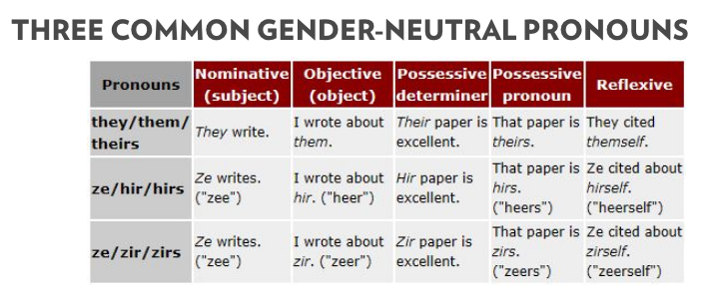
Transgender 101
Pronouns
Refer to nouns when not specifically using the noun proper name
Notes:
Pronouns are Words used to refer to nouns when not specifically using the noun proper name. She and He are the most commonly used and refer to Men and WOmen. Because of this pronouns express gender. Some people who do not identify within the binary or nonbinary people prefer gender neutral pronouns. They/Them is probably one you might have heard of before. For example using this in a sentence. Jess spoke during services about gender. They taught me a lot. To help trans people not feel like they are singled out it can be helpful when you introduce your name to also add your pronouns.
Not everyone that is nonbinary uses they/them pronouns. Pronouns do not equal gender. It is not best practice to use they them pronouns for people who “look trans”. Instead take time to practice pronouns on your own, in your case notes,

Slide 15
Transgender 101
Disparities
High rates of attempted suicide
American Academy of Pediatrics
26% of Black trans women live in extreme poverty
Compared to about 15% of general population
LGBT National Task Force
Life expectancy of trans women is 35
Even shorter for Black and Indigenous trans women
Inter-American Commission on Human Rights
Notes:
Misgendering of reported harm / death
Oppsticles and hoops related to resources

Slide 16
Sexual Violence
Notes:
10:50

Slide 17
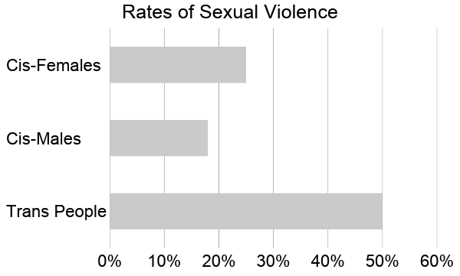
Notes:
47% of trans people have experienced sexual violence
2015 National Trans Center for trans Equality Survey
This study surveyed trans people from across the country
Not peer reviewed or academic peer review
Often not high enough sample size
Therefore data is ignored
Lived experiences of many people who face oppression in our country is not correctly portrayed if at all in academic research or peer reviewed sources
Also BIpoc especially BI and Trans people been dealing with these probelms and gfound their own solutions not relying on institutions

Slide 18
Notes:
Now we are going to listen to some lived experiences of trans folks

Slide 19
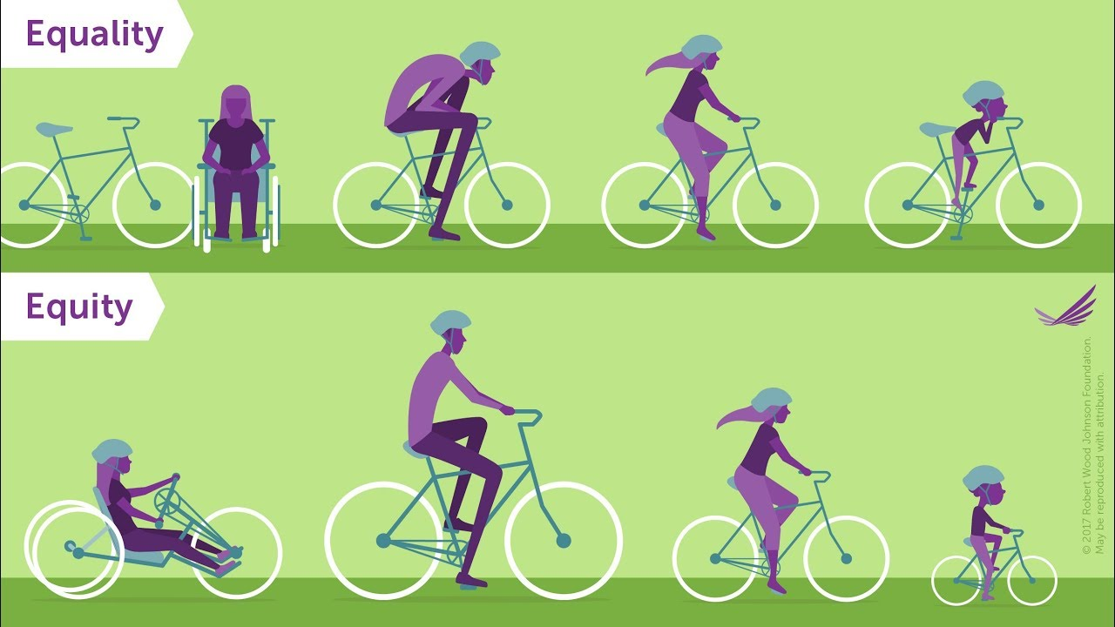
Notes:
Specific obstacles that trans people face - feel free to put ideas in jam board slide 5
Using Children
Using small LGBT survivors
Isolated
Outing
Using Children
Using small communities
Leveraging institutional violence / isolation
Alcohol and drug use
Isolation and OUTING - very vulnerable to abuse - they may be losing friends and family, may be alienated from their cultural, ethnic, religious, familial community and institutions. The isolation that most LGBT people face as a result of homophobia is useful to a batterer who is trying to isolate their partner. Threatening to “out” a person (which could mean losing children, ostracism, job loss etc) is a powerful tool of control
Using vulnerabilities often results in survivors being exploited (resources, time, attention) and undermines survivors’ attempts to negotiate boundaries or prioritize self. Using Children—In many states, LGBT people are not allowed to be the legal parent of their children. Even in states where LGBT parent’s rights are protected, not all individuals have access to the systems to assert their legal rights. For a non-biological parent, the threat of having no contact with their children makes leaving an abusive relationship a complex to impossible choice.
Using Small Communities—Using friends/family and the small number of open and affirming community spaces to monitor a survivor & gather information, to ostracize or threaten to ostracize the survivor. Please note: safety planning cannot rely on the survivor never being in community space with the batterer. Our communities are too small for this. We must do harm reduction planning or survivors “drop out” of community to avoid batterer and risk further isolation. Leveraging Institutional Violence / Isolation—law enforcement historically and currently have used violence against LGBT people.
LGBT people have been targeted for violence in mental health institutions, by hate and bias attacks, and are denied basic civil rights such as the protections afforded through marriage. LGBT people also experience discrimination and oppression based on race, class, national origin, gender, gender identity etc. Many LGB people, and particularly transgender people, have experienced discrimination within the medical system. These things are used by batterers to increase control. Alcohol and Drug Abuse—LBTG people have historically been forced to make community in “illegal” and marginalized spaces such as bars. We have higher rates of alcohol and drug use and abuse than in mainstream communities. Batterers leverage the ongoing consequences of ways that LBTG people’s lives have been historically criminalized AS WELL AS the realities of current drug use (and drug criminalization) when setting up/maintaining a system of power & control. Please see the “Think, Re-think” article in your packet for more discussion of these issues, stats, and a general frame of dv in lbtg relationships.
Often, the survivor has not committed a crime and is wrongly arrested. Such mistaken arrests occur more often to LGBTQ survivors than heterosexual survivors. One reason for this is that law enforcement may use the same indicators typically coded to gender differences in heterosexual relationships (relative size and weight, tone of voice, etc) to make determinations regarding the ‘primary aggressor’ in same-sex relationships. More overt homophobic and other bias plays a big role as well--when the survivor is larger, less visibly injured, more masculine, a person of color, or in some other way triggering to the biases of an officer or judge, they may be misidentified as a perpetrator
Survivors may be arrested for alleged domestic violence crimes and labeled a “perpetrator” while their abusers are identified as a “victim” by the criminal legal system.
Very common in LGBT relationships
When I worked in st. louis if they did not know who was the perpetrator they would arrest both parties
Almost all my LGBT cases both people were arrested
Deadnamed and misgendered
find out about the barriers LGBTQ survivors might face in accessing your services and other services in your area. Work collaboratively with community partners to decrease barriers and increase the accessibility of your organization and the broader response to LGBTQ survivors in your region. • Learn about the laws in your city and state as they impact LGBTQ survivors. • Be aware of LGBTQ supportive counseling, medical, and legal resources in your area. If you are struggling to find resources in your area, explore referrals to LGBTQ competent services who may be able to work with people remotely in your area. • Make alliances with LGBTQ-friendly people in the police department, court system, and other service agencies. • Find ways to collaborate with LGBTQ community organizations, such as LGBTQ specific mental health services, clubs, HIV/AIDS programs, medical clinics, or recovery groups. • Attend trainings on LGBTQ issues; offer LGBTQ organizations information, resources and training on domestic and sexual violence.
Feel communities
Leveraging institutional violence / isolation
Alcohol and drug use

Slide 20
Power Dynamics
Notes:
11

Slide 21
Triangle of Consent
Communication
Power
Agency
Created by Crystal Byrd Farmer
Notes:
The triangle of consent expands the consent beyond the basics of who, what, and how with the recognition of agency and power balances and ends with specific communication about sexual acts. If one part is missing or abbreviated, it will affect the entire experience of giving and obtaining consent.
This specific way of talking about consent comes from Crystal Byrd Farmer (she/her) who is an engineer turned educator, organizer, and speaker who focuses on cohousing, Black, and polyamorous communities. She is passionate about encouraging people to change their perspectives on diversity, relationships, and the world.

Slide 22
Triangle of Consent
Agency
Created by Crystal Byrd Farmer
Notes:
Agency is the recognition that we all have the ability to make choices for ourselves. We make those choices based on available information and our own judgment. When we’re in a relationship, disclosing relevant information is the way we recognize our partner’s agency. For example, when going on a date with someone a potential partner may say they are seeing others. Someone in a relationship may, telling a partner that they have an attraction to someone else. This information usually affects the partner’s future actions, which is why it’s difficult and sometimes embarrassing to talk about. When we withhold information, we are taking away some of our partner’s agency. When a partner has the right information, they can respond in a way that will protect their own safety and peace of mind. Another part of agency is each person’s ability to understand the situation. Children, teenagers, sometimes neurodiverse, and those under the influence of drugs and alcohol often lack the social awareness that will give them the information needed to give
e or obtain consent.

Slide 23
Triangle of Consent
Power
Created by Crystal Byrd Farmer
Notes:
Power that someone has in sexual situations should always be acknowledged in order to move forward with consent. Any relationship can have a power imbalance. Someone has more seniority, wealth, status, or social support than their partner. People need to consider why their partner is saying yes to engaging in sex, if they are using their position or privilege to get the sex they want, and if their partner can say yes in fear of consequences. If the relationship has an extreme power difference or someone is using power and control then consent is meaningless because they are coersed.
When someone lacks agency or power, they do not consent and can be coerced. Coercion is using ignoring agency and pushing for a sexual act until someone gives in. Some examples include pressuring, threatening, Intimidating, blackmailing, and guilt-tripping. For example a non-sexual time I may have been slightly coerced was when my sister pressured me to attend the family reunion so she had someone to go with. I did not want to go but my sister made a comment like come on do you really want to disappoint mom?
THinking of power dynamics is extremely important especially in the context of trans survivors. We in this work should be reflecting on our own identities and how that relates to how we show up and are seen by the world .

Slide 24
Triangle of Consent
Communication
Created by Crystal Byrd Farmer
Notes:
Communication guides agency and power into fully informed consent. In an ideal world most sexual acts would be verbaly confirmed by each partner. In reality consent is often given nonverbally through smiles and shy touches. One issue with that is that people can reflect back and see a point when they were unwilling to continue.
How does this communication look? It is bluntly said out loud to the other person. “You are really cute, can i kiss you?” “You looked so hot today, I would really love to have sex if you are down?”
Consent should verbally be asked before dirty talking, touching genitalia or enrogencous zones, any penetration. Recognizing agencies also have conversations about STIs, date of last time tested, any current sexual partners, use of condoms, use of birth control, and any physical or emotional limits.Consent is best practiced before going to the bedroom. Overtime these conversations get easier
focuses on cohousing, Bt.

Slide 25
Underground Economic Work
Complex
Survival Tactic
Highly Stigmatized
Notes:
Because people are transphobic many trans people engage in undergrad economic work. This includes sex work, drug sakes and other activties that are currently criminalized to earn an inome, a place to sleep, exchange for food, or other goods/services. In one study 20% of trans people participated in the underground economy for income and that number increases for uncdocumented and BIPOC trans people. It is important to remember that because of stigma and our country making these types of work illegal it makes it more violence and unfortunately the people that engage in it are more likely to experience seuxal violence.

Slide 26
Transformative Justice
Notes:
One way of building community care
11:30

Slide 27
Transformative Justice
Center Indigenous, Black, Brown, communities
Belief that people who caused harm can change and that we all can play a crucial role in that shift
Notes:
Transformative Justice historically developed by BI, women. There was no institutional support and history of eraser of identities, ideas, and experiences
Indigenous, Black, and brown communities with women at the front
Belief that people who have caused harm can change and that we can all play a crucial role in catalyzing that shift
Hold people accountable by
Recognize the harm they have done even if it was not intentional
Acknowledge that harm’s impact on the individuals and the community
Make appropriate restitution to the individual and community
Develop solid skills for transforming attitudes and behavior to prevent further harm and make contributions towards liberation

Slide 28
Shouting self-care at people who actually need community care is how we fail people
Nakita Valerio
Notes:
Nakita Valerio was exhausted and frustrated by the number of responsibilities and the solution given was to practice “self-care,” felt like it was enough.
It had only been nine days since the terrorist massacre of 50 Muslim worshippers in Christchurch, New Zealand.. I felt unable to move or do anything to help myself knowing that one step with no end in sight. I felt like other people, especially non-Muslims, needed to step up to share the challenges that come with just existing as a Muslim woman.
Wrote on Insta Shouting 'self-care' at people who actually need community care is how we fail people
Community - Muslim organization focuses on sexual health and prevent sexual violence explains it as
Over the last few years, there’s been a lot of
buzz about self-care. And, while self-care may be
defined differently from person to person, there’s
a general cultural understanding about what it is. Generally speaking, self-care is the act of an
individual attending to their needs.
However, community care is a term that is rarely
used outside of movement spaces yet is an
essential ingredient needed for collective healing
and restoration. In a Facebook status that
eventually went viral, Canadian organizer
Nakita Valerio wrote,
"SHOUTING ‘SELF-CARE’ AT PEOPLE WHO
ACTUALLY NEED ‘COMMUNITY CARE’ IS HOW
WE FAIL PEOPLE.”
Community can be defined many different ways. For
some of us, our communities may be defined by
geography - the places in which we live, work, pray,
and play; by fellowship and shared values with others -
those we engage in spiritual practice with, those we
feel most connected to; or by the purposes or causes
we feel connected to. For a lot of us, it is likely some
combination of those.
So, what is community care and why isn’t self-care
enough? Community care is the important work of
taking care of our communal ecosystems, the people
and places we are in community with.
Now more than ever, cultivating a sense of
community is integral As
we try to build a new normal and want to
explore all the ways we can continue to foster a
sense of belonging with one another in the post pandemic world
It is OUR duty to not only acknowledge our privilege but to take one step further and leverage our privilege to help and support our communities

Slide 29
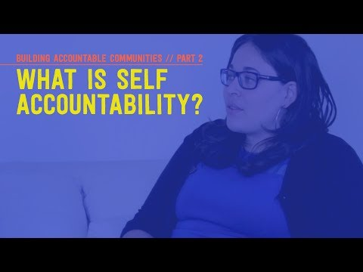
Notes:
First place to start is accountability with self and organization

Slide 30
Accountability
Self Accountability
Self Reflection / Identification
Margins of Center Worksheet
Lifelong Unlearning
Internal Community Building
External Community Building
Notes:
After addressing this extensively in our selves and our work spaces then can truly begin to use accountability
Again remember a hugely important part of this work is the internal work and reflection on power dynamics and identity. We must strive to have a deep understanding of our different identities and how they show up in the work
Gather the community internal you already have relationships with and help and focus on part one and putting those lessons into the organization.
Then internal work collaboration. Identifying of power dynamics by those in power and with privileged identities in our work spaces / departments. I highly recommend that agencies look into being non-hierarchical because this mission will be easier and honestly the power dynamics will almost always mean there is not really community as you report to and could be fired by someone there is inherently a power dynamic.
Then creating an environment where everyone - every single person actually can contribute - often times we think that we are there but there is always more we can do to step back or echo others voices
Internal and external community building should be lead by those who experience the most marginalization instead of those in power in the organization

Slide 31
Resources

Slide 32
Resources
Beyond Survival
Trans Lifeline
I Believe You, LLC
Northwest Network
Magins of Center Worksheet
This Book is Anti-Racist
Love is Respect

Slide 33
Questions?
Jess Rubinsky, MSW
ibelieveyoullc.com
jr@ibelieveyoullc.com
Do you have any questions?
youremail@freepik.com +91 620 421 838 yourcompany.com
Please keep this slide for attribution

