Slide 1
Embracing Intersectionality:
A Sexual Assault Support Group for Black Women
Presented by: Amy Merkle and Michelle Dennis

Slide 2
Introducing Michelle Dennis
Michelle has worked at SafeHouse Center for 3.5 years as a Legal Advocate, Crisis Support Advocate, Support Group Facilitator and 24 Hour Response Team member and continues to advocate for Black survivors
Michelle created the Black Women Support Group and it’s curriculum. The group began meeting January 2021 via Zoom
Michelle has a passion for helping others in crisis situations, but especially children and their families

Slide 3
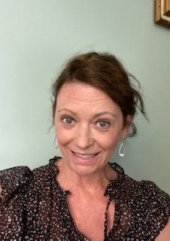
Introducing Amy Merkle
Amy has worked at Safehouse Center for 23 years, Currently the Coordinator of the Sexual Assault Services Program which includes overseeing crisis support advocates, a felony legal advocate and outreach advocate
Amy has trained staff & volunteers on group facilitation and has run the following groups: Washtenaw County Jail & Women’s Prison group, Sexual Assault, Teens and Men’s group.
Amy has a passion for providing Sexual assault survivors the space to feel heard, validated and believed.

Slide 4
SafeHouse Center Eligibility and Philosophy
Provide support to those impacted by domestic violence and/or sexual assault
Philosophy of services:
Feminist
Peer
Empowerment
Our services are free and confidential
We serve all who live, work, attend school or were assaulted in Washtenaw County

Slide 5
SafeHouse Center Services
Domestic Violence Crisis Intervention & Support Group
Shelter & Transitional Housing
Legal Advocacy
24 Hour Helpline
Community Outreach
24 Hour Response Team
Children & Youth
Sexual Assault Crisis Intervention & Support Group

Slide 6
Support Groups
Our support groups provide a safe environment as well as
Support and healing from the abuse someone may have experienced
•Sexual Assault Drop In Group- Monday 6-7:30pm
•Black Women SA group – Wednesday 6-7:30pm
•Men’s Sexual Assault Drop In Group- Wednesday 6-7:30pm
•LGBTIQ SA survivor 6 week group- Tuesday 6-7:30pm
•Safe Connections for Intellectual & Developmental Disabilities
•Friends & Family Workshop

Slide 9
Needs and prevalence: Why create a group for a specific demographic?
1 in 5 Black women are survivors of rape
More than 20 percent of black women are raped during their lifetimes — a higher rate than among women overall
African American girls and women 12 years old and older experienced higher rates of rape and sexual assault than white , Asian, and Latina girls and women.
However Black women infrequently report their perpetrators to the police, often are not aware of resources available to them that can support them in their healing and therefore do not reach out for support.
For every Black woman who reports rape, at least 15 Black women do not report.

Slide 10
Important Elements
Create a safe space for Black women to process their trauma
Encouragement for Black women in their healing process
Empower, support and help educate Black women
Understanding the power and control wheel

Slide 11
Funding & Advertisement
Funding:
Proposal submitted to VOCA
Grant accepted for SA program
Required for advocate in program to facilitate group that was created
Advertisement:
Created flyer; mailed to local agencies in surrounding area and posted to social media sites
Mass email sent to list server in the county
Advocates spread word of mouth to clients actively participating in SHC services

Slide 12
Creation of the group
Understanding a need for this particular group
Black history and sexual assault
Curriculum based
Empowerment of Black women
Healing process
Discuss issues Black women face
Focus on childhood trauma
Open group, meets weekly for 1.5 hours
Confidentiality and guidelines for group

Slide 13
Eligibility requirements
Identify as Black
Identify as a woman
Live, work or was assaulted in Washtenaw County, MI

Slide 14
Some Curriculum Topics . . .
Coping
Healthy vs unhealthy coping mechanisms
Disclosure of assaults
Barriers Black women face
CPS involvement
Lack of resources
Emergency response
Court processes
Criminal felonies vs misdemeanors
Personal Protective Orders (PPO’s)
The healing process
Support systems
Letting go of shame and guilt
Grieving over the relationship
Expectations & stereotypes of Black women
Rape culture
The stigma and why mental health support is important for Black community
Society, family, friends, self
Self-esteem and self-worth
Self-image and self-identity
Self-care
Trauma & responses to trauma
Safety planning

Slide 15
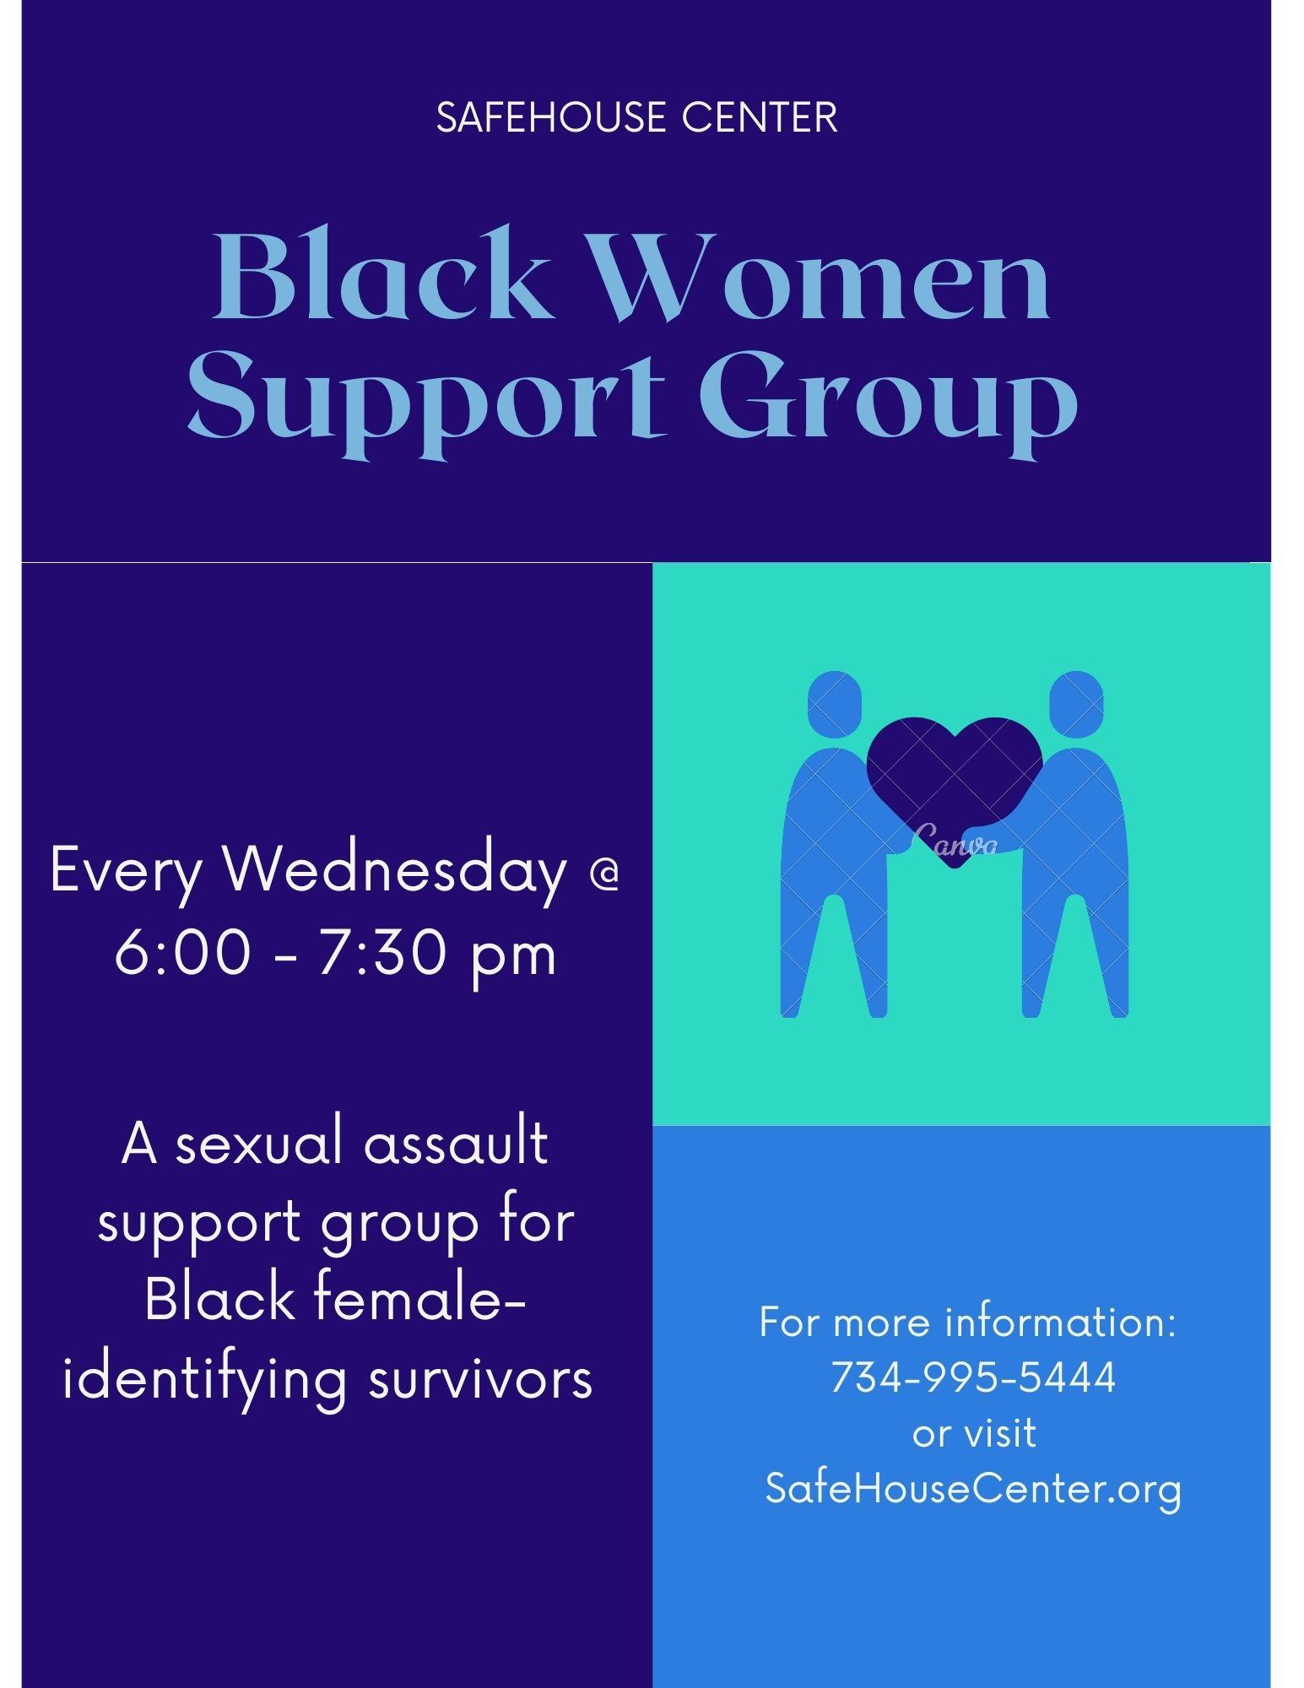
Begin group with check-ins
Processing
Topic of discussion
Black poetry or songs used
End with Black meditation, affirmations and/or self-care

Slide 16
Advocate offers support outside of group!

Slide 18
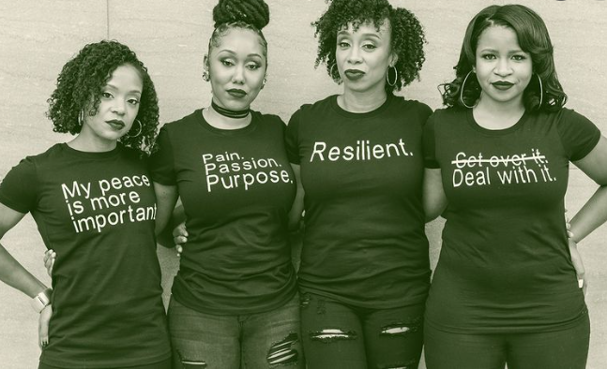
Open Discussion . . .
How can healers and mental health workers create emotional safety and freedom for Black women?
How are you supporting Black women?
How is your organization disrupting practices that discourage Black women from seeking help?

Slide 19
Presenter’s Contact Information
Michelle Dennis
Email: michelled@safehousecenter.org
Amy Merkle
Email: amym@safehousecenter.org

