Slide 1
Black Girl Magic/Fat Girl Liberation
Traci Simmons, MAMFT & Amy Turner, LPCC

Slide 2
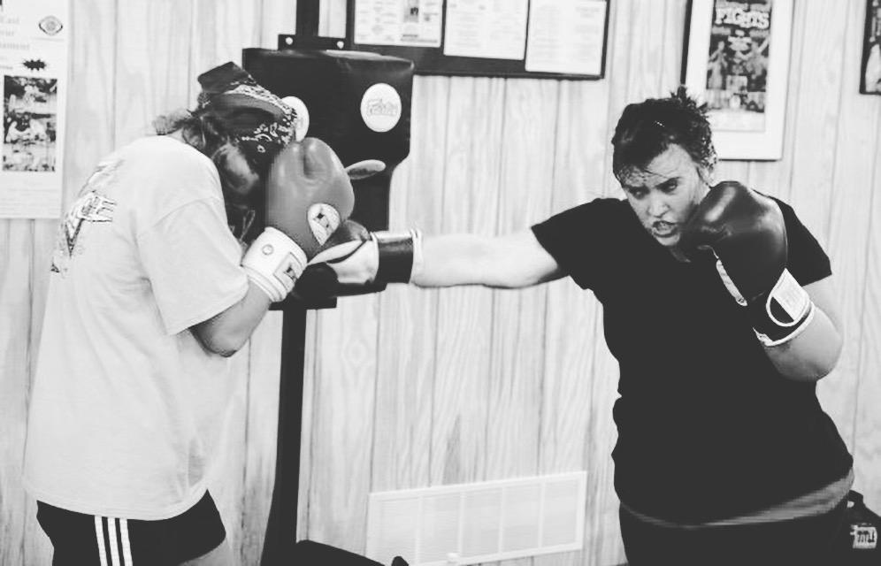
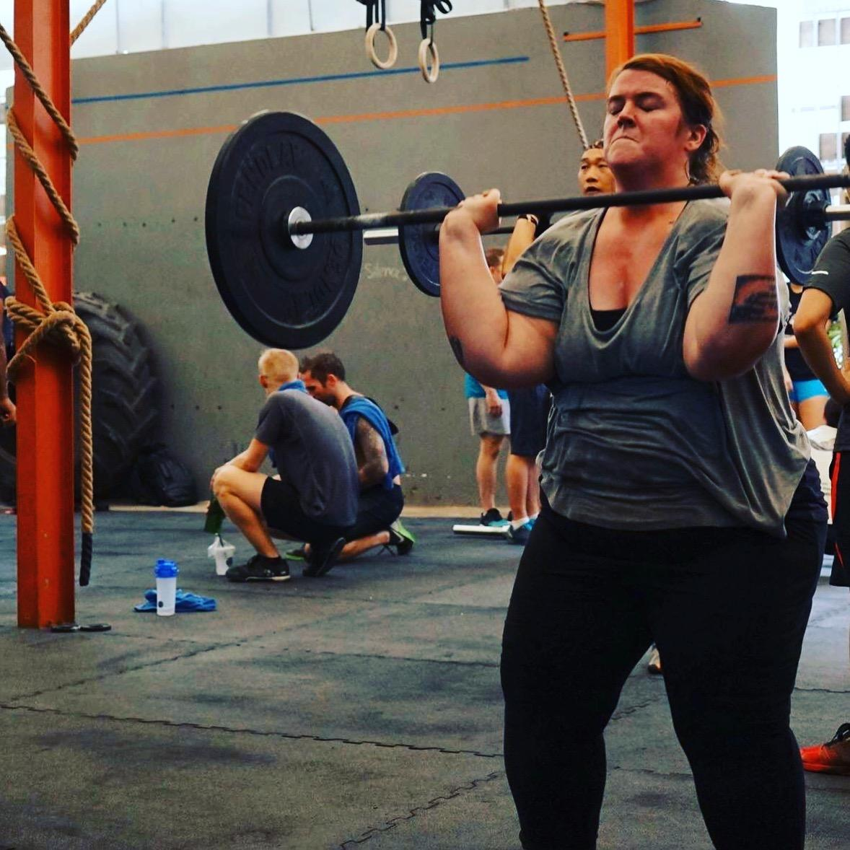
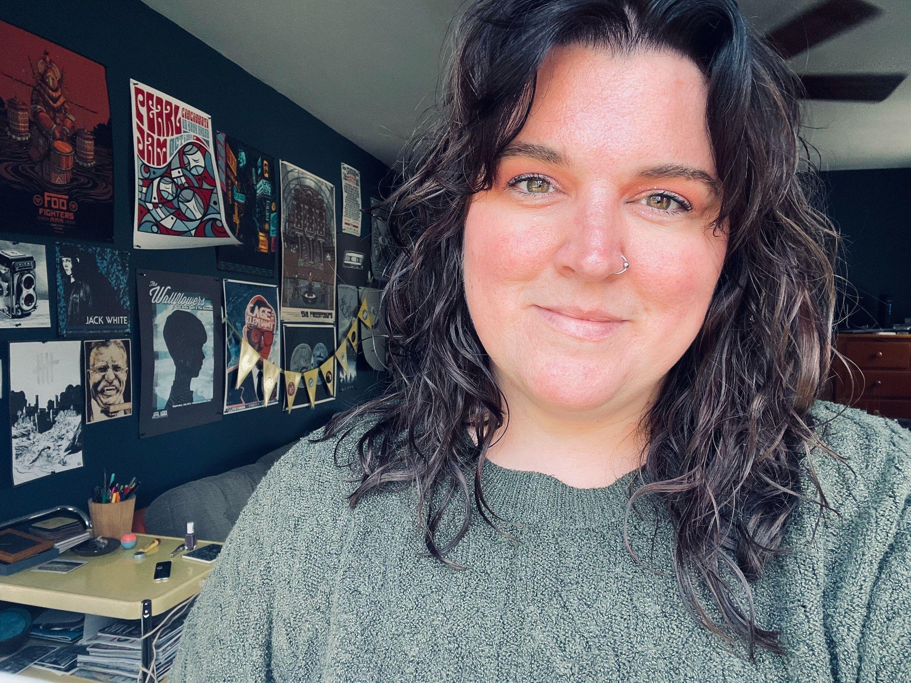
AMY TURNER
HOMETOWN: Fairdale, KY
EDUCATION: BFA in Studio Art and Theatre from Millikin University, MEd. from University of Louisville in Counseling and Expressive Therapies
HOBBIES: Muay Thai, Olympic Weightlifting, Photography, making clothes, traveling, reading, building stuff,tattoos, listening to records, playing guitar or piano, teaching myself the ukulele, and theatre.
MY LIBERATION:

Slide 3
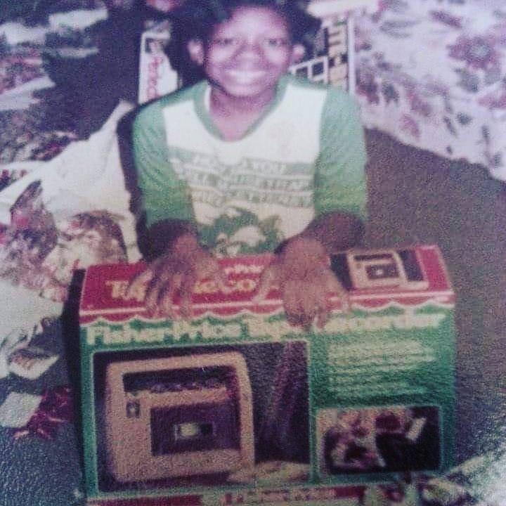
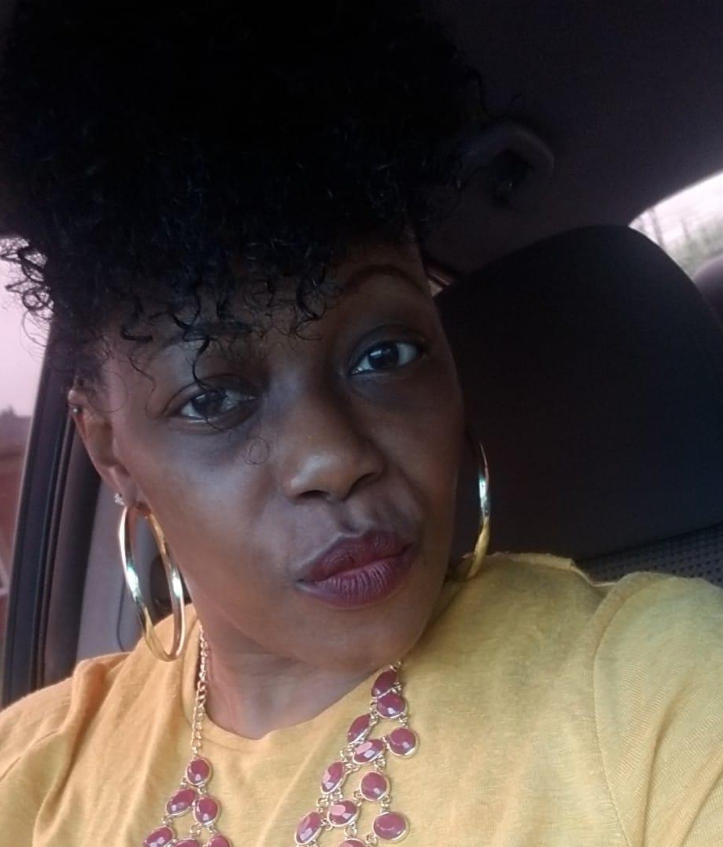
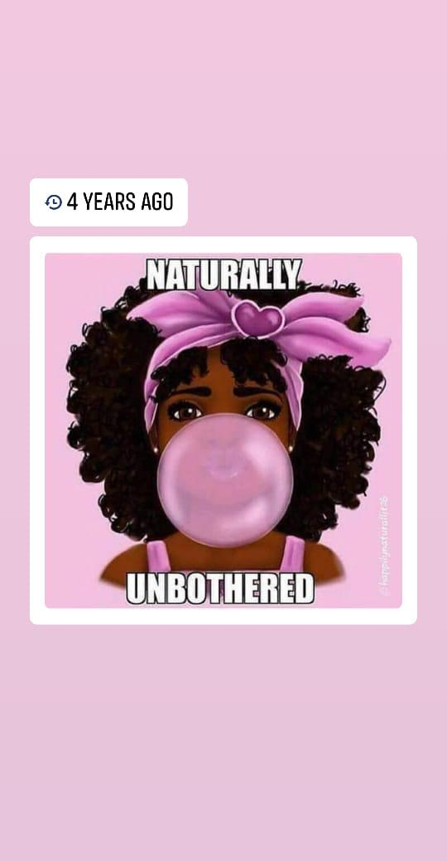
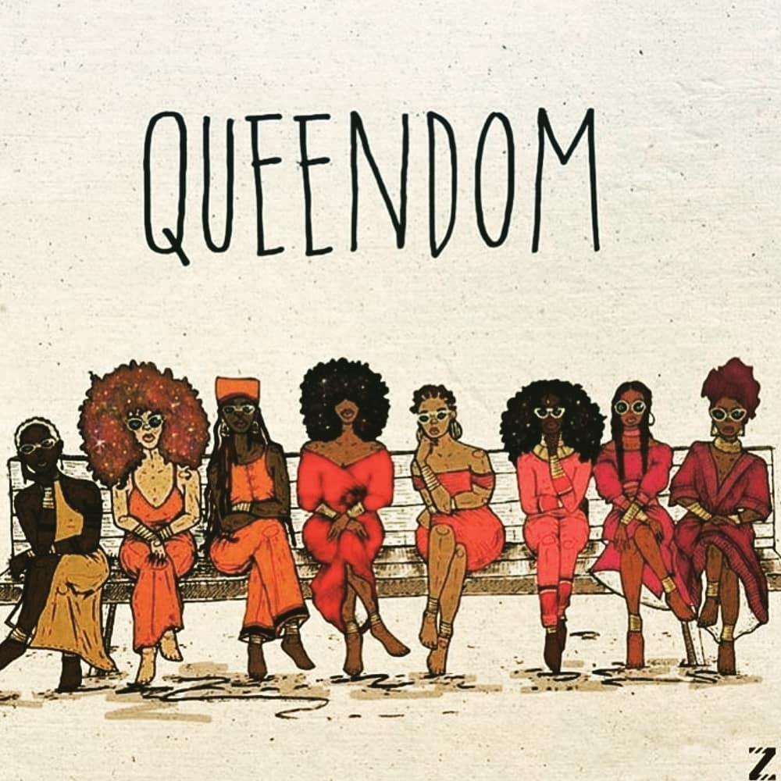
TRACI
SIMMONS
HOMETOWN: Louisville, Ky
EDUCATION: BS in Hospitality Management w/Minor in Business from University of Kentucky. Masters of Divinity and Master of Arts in Marriage and Family Therapy both from Louisville Seminary.
HOBBIES: Reading, sleeping, traveling, singing, listening to music, connecting other people to each other, professional networker ;-), live music, plays, habitually overstepping lines and cooking
MY BGM: .

Slide 4
UNIVERSAL PRECAUTION
Presume that every person in the human services setting has been exposed to abuse, violence, neglect, or other traumatic experiences.

Slide 5
GROUP AGREEMENTS
Safe Space/Brave Space​
Vegas Style​
Move Up, Move Up​
E.L.M.O.​
1 Mic​
You’re learning something new
...Anything else?

Slide 6
HOW DID WE COME UP WITH THE TITLE OF THIS PRESENTATION?
AMY’S CREATIVITY
TRACI’S PERSISTENCE
COMFORTABILITY OF OUR OWN BODIES
FRUSTRATION WITH CONVERSATIONS ABOUT “BODY POSITIVITY”

Slide 7
Objectives
An understanding of the history of the fat body
The intersectionality of Racism and Diet Culture
The barriers to service for Black and Fat femmes
Practice in working with Black and Fat femmes
Liberation for you, in your body

Slide 8
HISTORIC SUBJUGATION OF BLACK WOMEN'S BODIES
“THE CAMERA NEVER LIES”
19TH CENTURY PHOTOGRAPHS FROM BRITISH COLONIZERS
PARTICULAR INTEREST IN THE NAKED BODIES OF BLACK WOMEN
FOCUS ON BREASTS, BUTTOCKS AND LIPS
ASSUMPTION OF ANTICIPATION
FETISIZATION OF THE BLACK FEMALE BODY

Slide 9
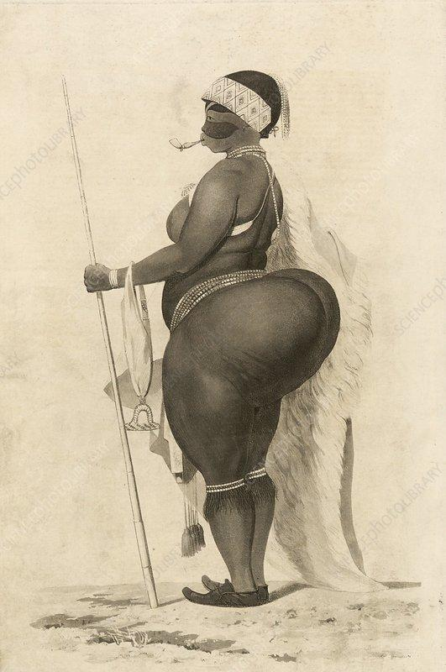
MOST FAMOUS FETISHIZED BLACK WOMAN
Saartje (Sarah) Baartman

Slide 10
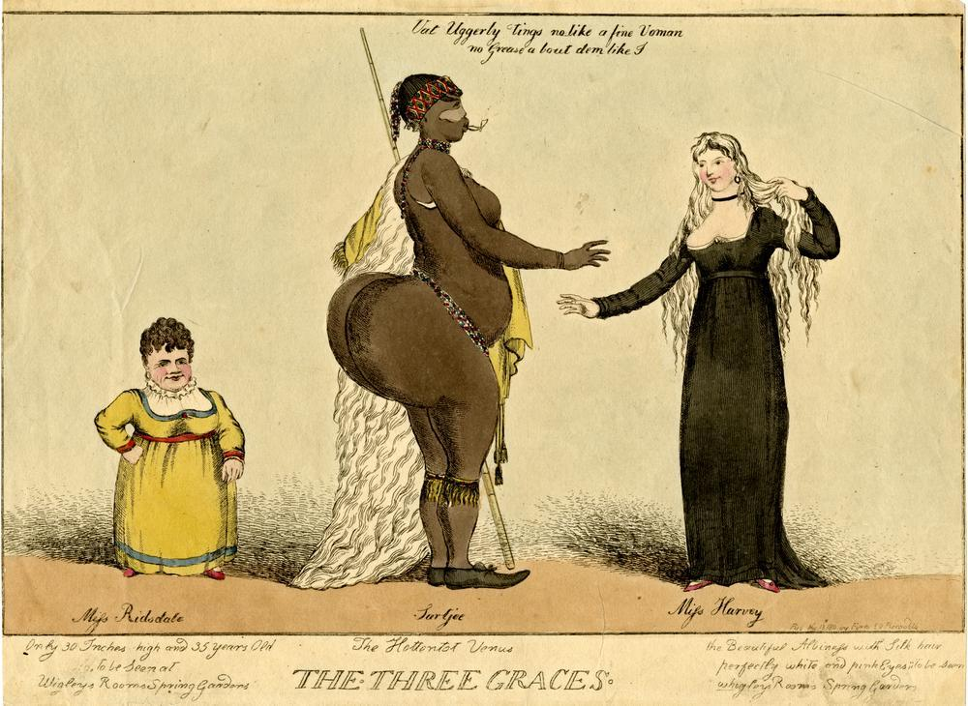
1789- 1815
Traveled around Europe on a “freak show”
Hottentot Venus
Body dismembered
Body parts preserved for French museum
Laid to rest in South Africa in August 9, 2002

Slide 11
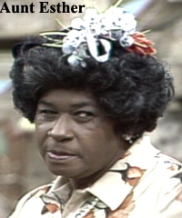
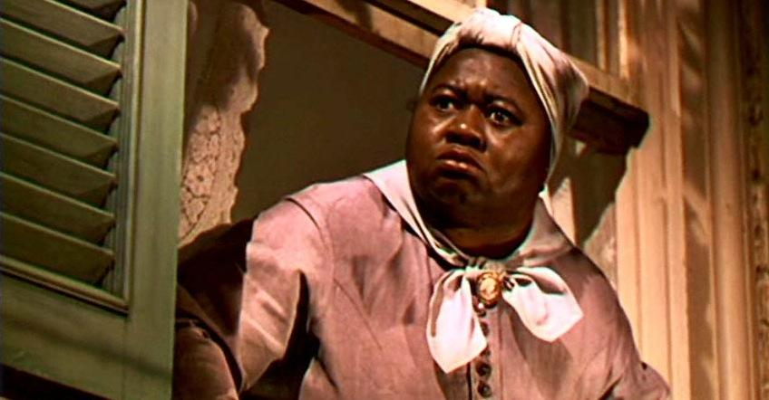
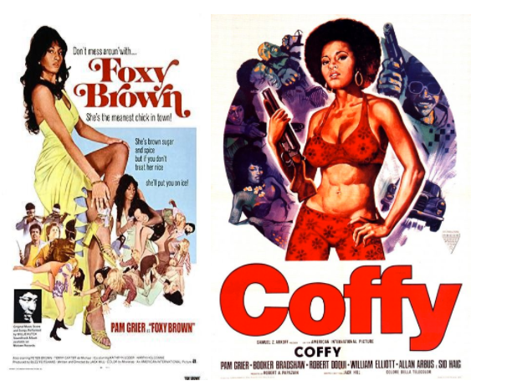
THREE STEREOTYPES OF BLACK WOMEN
MAMMY
Mammy -The overweight, kerchiefed, aproned servant/nurse who is happy with her life of faithful service to others (usually, white people) -Matriarchal, no sex appeal -Portrayed as being loyal and having a good heart -An endearing, comic figure
SAPPHIRE
The “sassy black woman”, portrayed as having one hand on her hip, and the other hand wagging a finger in the air -Overbearing, and known for berating their men and children -Rude, loud, and confrontational -Often overweight, and the sidekick to a more beautiful black female character
JEZEBEL - A seductive, lewd, alluring, worldly, tempting figure -A foil to mammy -Often tall and lighter skinned, with facial features more typically associated with white women -Often portrayed as using sex as a tool for evil and manipulation

Slide 12
BMI -
RACIST ORIGINS
19th Century - Belgium Lambert Adolphe Jacques Quetelet
Created Quetelet Index - Weight to Height Ratio
ALL research conducted on white men
Never intended to measure health or wellness

Slide 13
WHAT HAPPENED……
LATE 20TH CENTURY, HEALTH AND LIFE INSURANCE COMPANIES ADOPTED THE QUETELET INDEX AND REPLACED THEIR OWN
INSURANCE COMPANIES LINKED EXCESS BODY FAT WITH THE INCREASE RISK OF HEART DISEASE
THIS WAS USED TO CONTINUE OR DENY INSURANCE
NATURALLY, BLACK WOMEN HAVE HIGHER FAT TO BODY TO MUSCLE RATIO
CREATED AN IMAGINARY IDEAL BODY TYPE BASED ON EUROPEAN WHITE MEN AND WOMEN

Slide 14
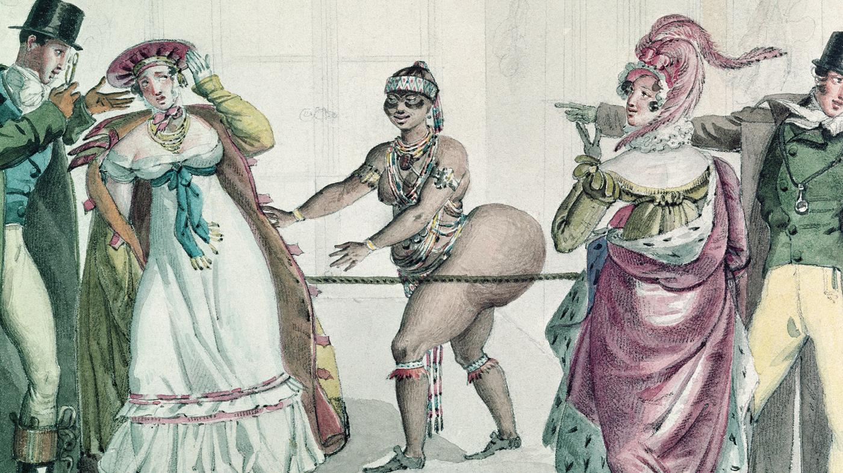
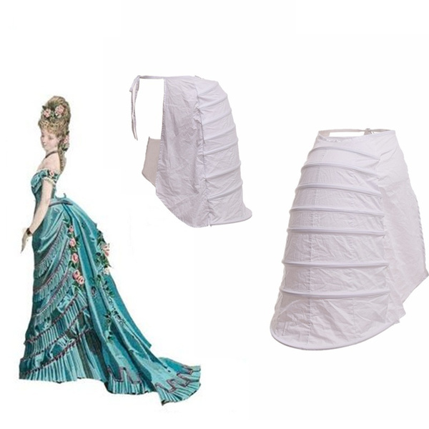
HOWEVER……..
…… HISTORICALLY, FATNESS WAS ASSOCIATED WITH WEALTH AND CLASS FOR WHITE WOMEN
BLACK WOMEN ARE NOT AFFORDED THE SAME LIBERTY

Slide 15
Fat Girl Liberation
Fatness goes back, at least 25,000 years as the ideal body type.
Even in the book of Isaiah, fatness was thought of as a “way to freedom”.
It’s depicted in many Chinese, Egyptian, and other cultures as the “ideal body type”.
A History

Slide 16
So when did that all change?!

Slide 17
Fatness and the Femme Body
In the late 19th century, An idealised image of a woman with a slight shape and a small, corseted waist, sloped shoulders, tapered fingers and delicate feet started to emerge in North America and Western Europe.
Overweight/Fat women, began to be seen as “undesirable”, unintelligent, and greedy.
The Femme body has changed throughout the years, but seemingly the same in treating the larger, fatter body as not ideal.
85% of femme identifying people develop some body dissatifaction/dysmorphia by the age of 13.
Most femmes starting dieting between the ages of 8-10 years old.

Slide 18
Intersectionality

Slide 19
Black Girl Magic and Fat Girl Liberation
OBJECTIFICATION
“SHE HAS A BLACK GIRL BOOTY”
“SHE’S A BEAST”
HYPER VISIBILITY VS INVISIBILITY
DEHUMANIZATION
SLAVERY
J. MARION SIMS
MEDICAL/HEALTH CONSEQUENCES
COMMODIFICATION
SEXUAL DESIRES
ENTERTAINMENT
LEISURE

Slide 20
ACTIVITY: WHAT DID YOU CALL ME?
IN THE CHAT BOX, SHARE SOME OF THE WORDS USED TO DESCRIBE “FAT” WOMEN

Slide 21
Fetishization of the Black Girl and/or Fat Girl

Slide 22
Sexual Assault of Black Girls and Fat Girls
Fat Black Girls
Black girls are assumed to be older than their actual age
Fat black girls are often ignored and not believed
Oversexualization and fetisization of black female presenting body
Demonization of curves until popularized amongst cultural majority
Fat Girls
Fat femmes are often seen as unreliable and less credible.
Fat femmes are often seen as undesirable, “who would want to have sex with you?”
Fetishization of Fat femmes
The notion that Fat femmes are desperate.

Slide 23
Over 18% of Black women will be assaulted in their lifetime - those who report
Misogynoir
For every 15 assaulted, only 1 reports their assault
Tension with being complicit and need for justice
https://now.org/wp-content/uploads/2018/02/Black-Women-and-Sexual-Violence-6.pdf

Slide 24
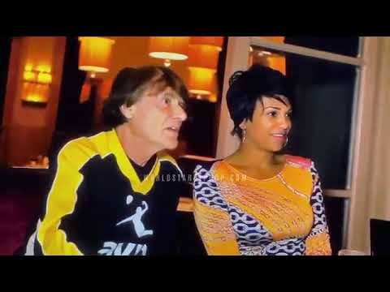
THIS IS WHY BLACK WOMEN ARE MAGICAL

Slide 25
Cultural Figures
Lizzo
Melissa McCarthy
Gabourey Sidibe
Monique
Queen Latifah
Ma Rainey
Amber Riley
Jill Scott
Margaret Cho
For Black Girls and Fat Girls

Slide 26
References
Black Girl Magic:
Killing the Black Body by Dorothy Roberts
Black Bodies, White Gazes by George Yancy
Oppression and the Body: Roots, Resistance, and Resolutions by Christine Caldwell
Medical Aparteid by Harriet A Washington
A Black Women’s History of the United States by Daina R Berry and Kali N Gross
Fat Girl Liberation:
Body of Truth by Harriet Brown
What We Don’t Talk About When We Talke About Fat by Aubrey Gordon
Things No One Will Tell Fat Girls by Jes Baker
Belly of the Beast by Da’Shaun Harrison
Heavy by Kiese Laymon
Hunger by Roxane Gay
Fearing the Black Body by Dr. Sabrina Strings
Bad Fat Black Girl by Sesali Bowen

